Slide 1
Enhancing Audio Classification using Feature Extraction and Machine Learning
Introduction to the project's objective:
Classification of audio files into two categories
Presenter: Abhishek Rajesh Saste

Slide 2
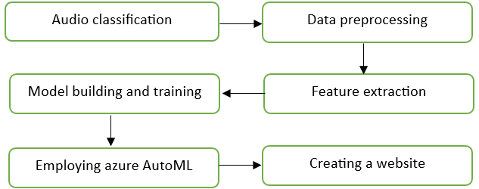
Introduction
This presentation is the journey of the pivotal phases that drove the classification of audio files and the subsequent improvement in model accuracy.
The figure below shows the flow chart of this project.

Slide 3
Introduction
This journey encompassed transforming raw audio data into trainable features, crafting a neural network architecture, addressing initial challenges, leveraging Azure AutoML for optimized results, and even creating a showcase website for real-time predictions.
From data preprocessing to model deployment considerations, this project encapsulates the exploration of audio analysis and machine learning.
The essence of each step is shown in this presentation, showcasing the potential of AI in the realm of audio classification.

Slide 4
Data Preprocessing and Feature Extraction
1.1 Data Conversion and Feature Extraction
At the start of this project, the audio data files were converted and the essential features were extracted using the Python library librosa.
By utilizing techniques such as Mel-Frequency Cepstral Coefficients (MFCCs), Chroma features, Zero Crossing Rate, and Spectral Centroid, the meaningful information from audio waveforms were extracted .

Slide 5
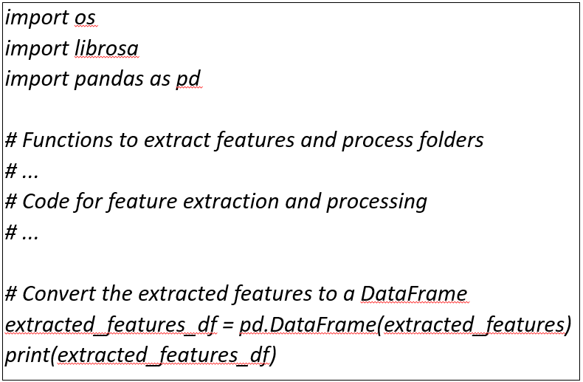
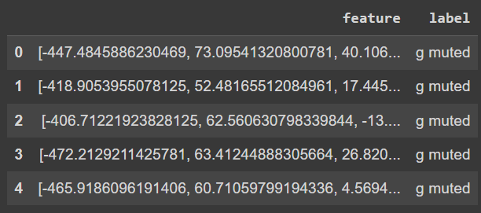
1.2 Code Overview
Steps to convert and extract the features
Results of the feature extraction

Slide 6
Step 2: Model Building
2.1 Sequential Model Architecture
After feature extraction, a Neural Network model using the Sequential API from Keras was designed.
This model consisted of several dense layers with rectified linear unit (ReLU) activations and dropout layers to prevent Overfitting.

Slide 7
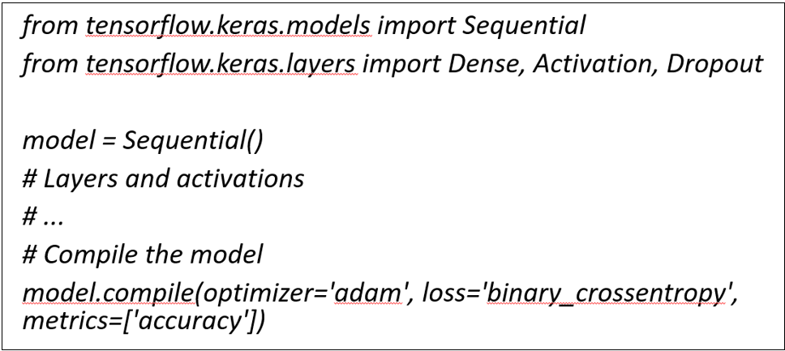
Step 2: Model Building
Initial model building for the training of the dataset

Slide 8
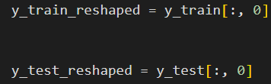
2.2 Model Training and Reshaping
The model was trained using the compiled architecture, optimizing the weights with the Adam optimizer and measuring performance using binary cross-entropy loss and Accuracy.
Additionally, the target labels for compatibility with the model were also reshaped.
Actual code of the target variables being reshaped

Slide 9
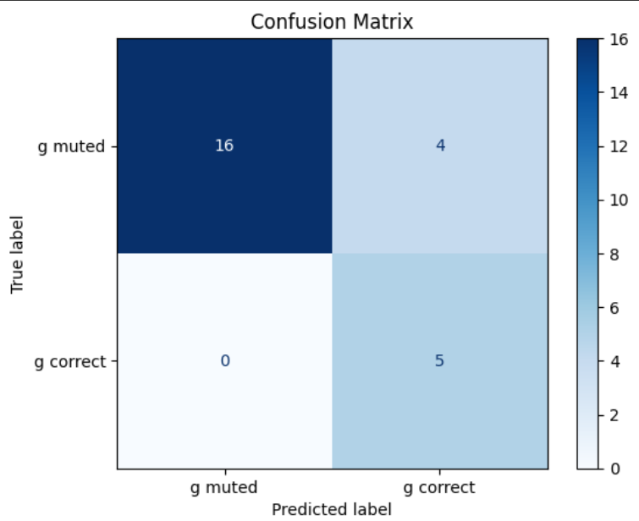
Step 3: Initial Results and Challenges
3.1 Initial Model Performance
After training, the initial results indicating a loss of 4.5814 and an accuracy of 73.96% on the training data were achieved.
The validation set showed a loss of 0.6410 and an accuracy of 84.00%. However, the testing accuracy was relatively low at 50%.
3.2 Challenges Faced
The challenges encountered included suboptimal model accuracy on test data and concerns about overfitting.

Slide 10

Step 4: Azure AutoML and Improved Results
4.1 Exploring Azure AutoML
To address the accuracy issue, Azure AutoML for automated machine learning was used as the potential platform to address this issue.
Azure AutoML helped to explore different classification models and tune their hyperparameters efficiently which is done automatically during the training process.

Slide 11
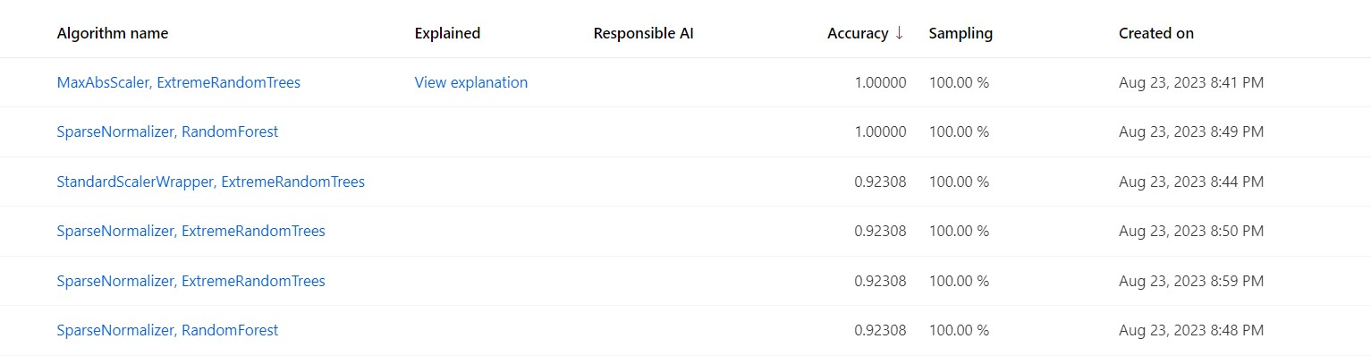
Step 4: Azure AutoML and Improved Results
4.2 Impressive Results
After running Azure AutoML for an hour, I achieved remarkable results. The training accuracy reached 100%, demonstrating the power of automated hyper parameter tuning as shown below.

Slide 12
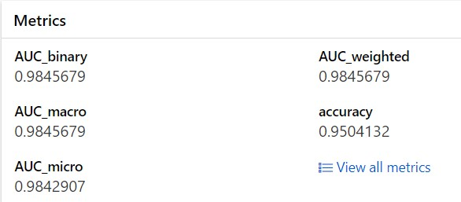
Step 4: Azure AutoML and Improved Results
4.2 Impressive Results
The testing accuracy also significantly improved to 95% as seen in the figure below.

Slide 13
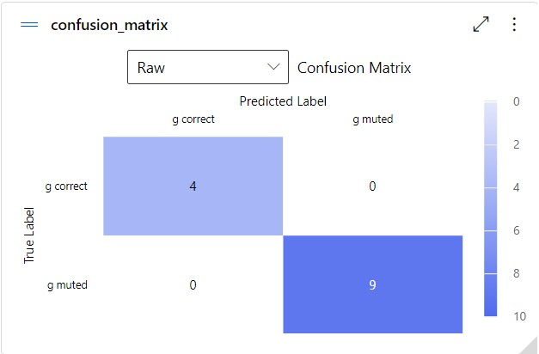
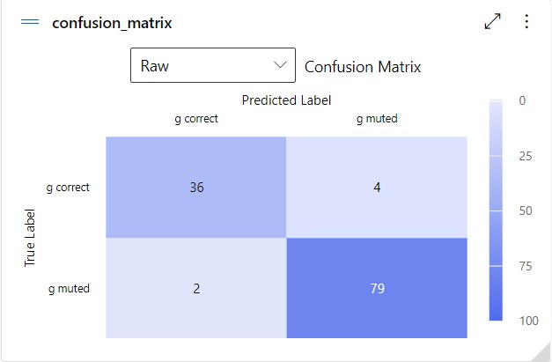
Step 4: Azure AutoML and Improved Results
4.2 Impressive Results
Confusion matrix on training dataset from the model achieved by training on Azure AutoML
Confusion matrix on testing dataset from the model achieved by training on Azure AutoML

Slide 14
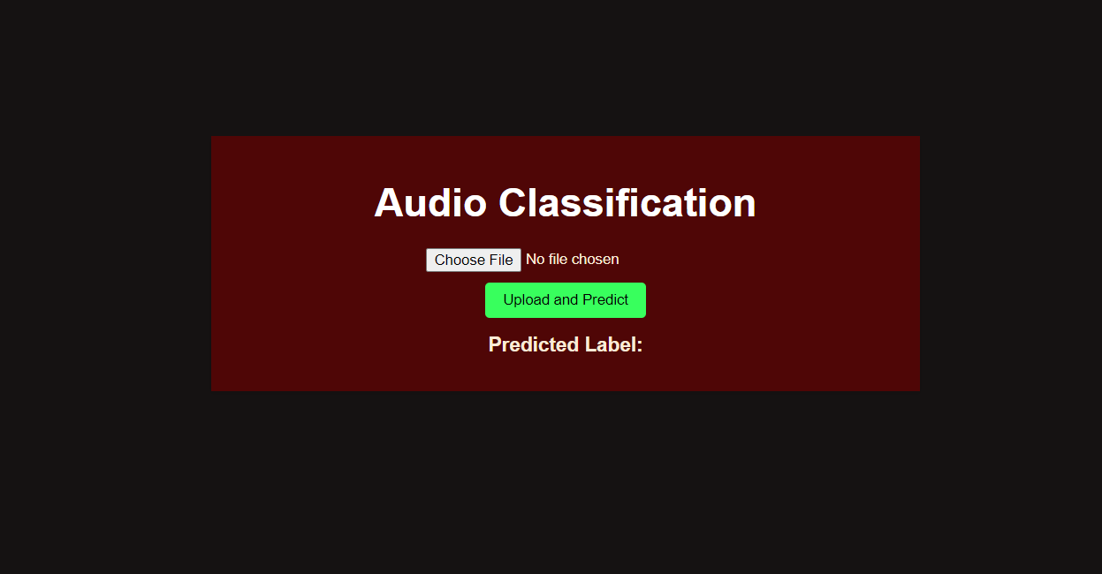
Step 5: Building a Showcase Website
5.1 Showcasing Predictions
With the improved model, a website was built to demonstrate real-time audio classification predictions.
This website allowed users to upload audio files and receive classification predictions instantly.

Slide 15
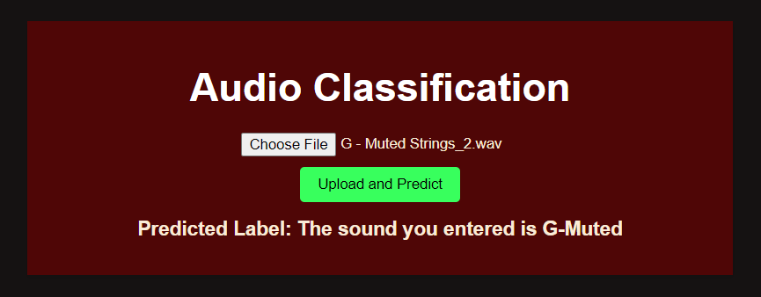
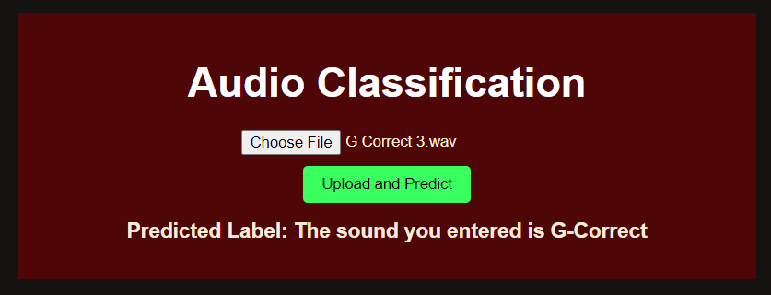
Step 5: Building a Showcase Website
Predictions made on the website

Slide 16
Step 5: Building a Showcase Website
5.2 Deployment Considerations
While the website was created successfully , the decision was taken not to deploy it to avoid incurring charges.
This allowed me to demonstrate the functionality without the financial commitment

Slide 17
Conclusion
In conclusion, this project was a journey of exploration and learning.
By applying feature extraction, model building, and leveraging automated machine learning through Azure AutoML, it was able to significantly enhance the accuracy of audio classification model.
While the showcase website remains offline, the success achieved in this project highlights the potential of AI and machine learning in audio analysis.

